Slide 1

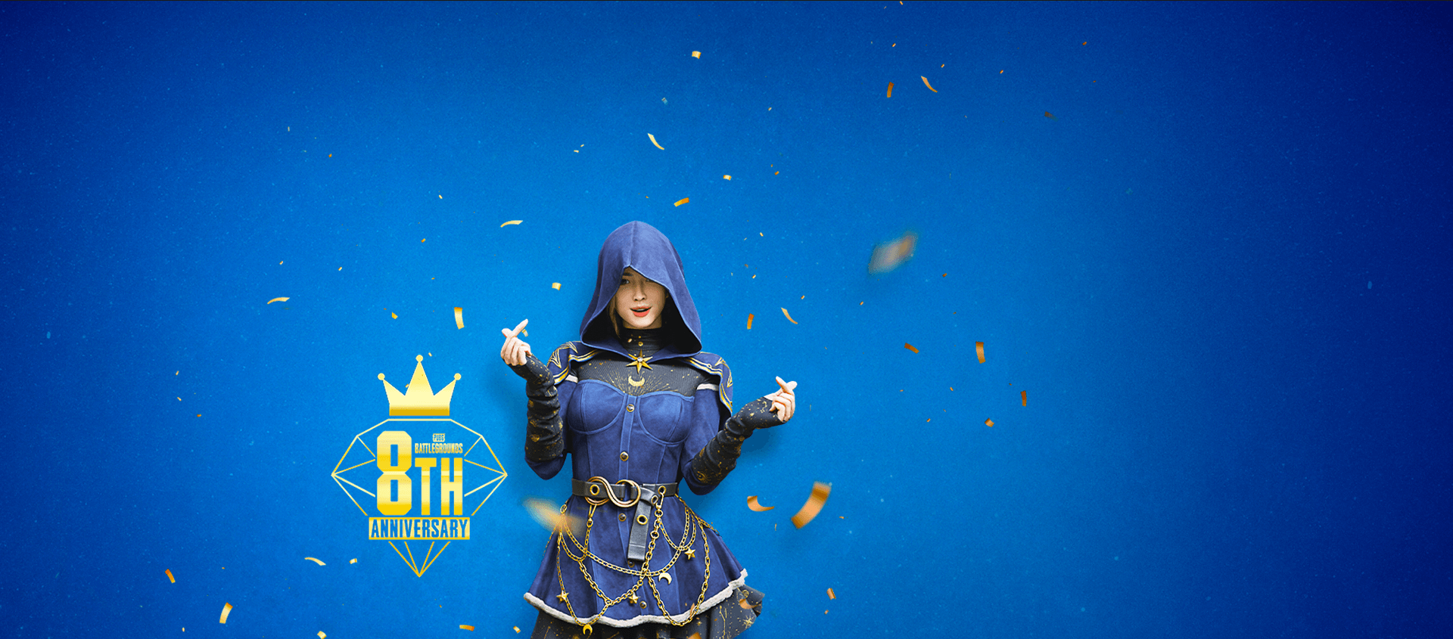

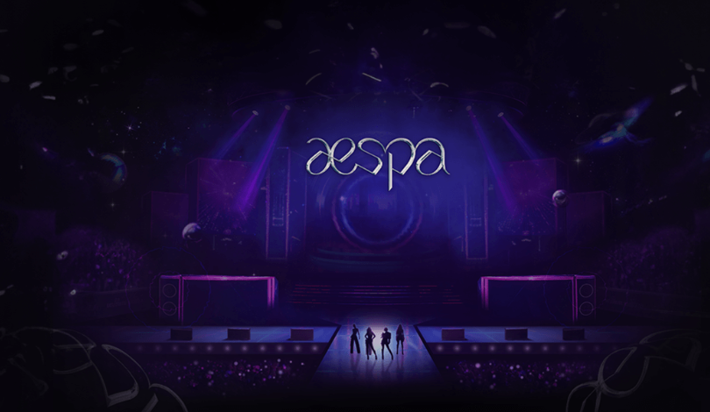
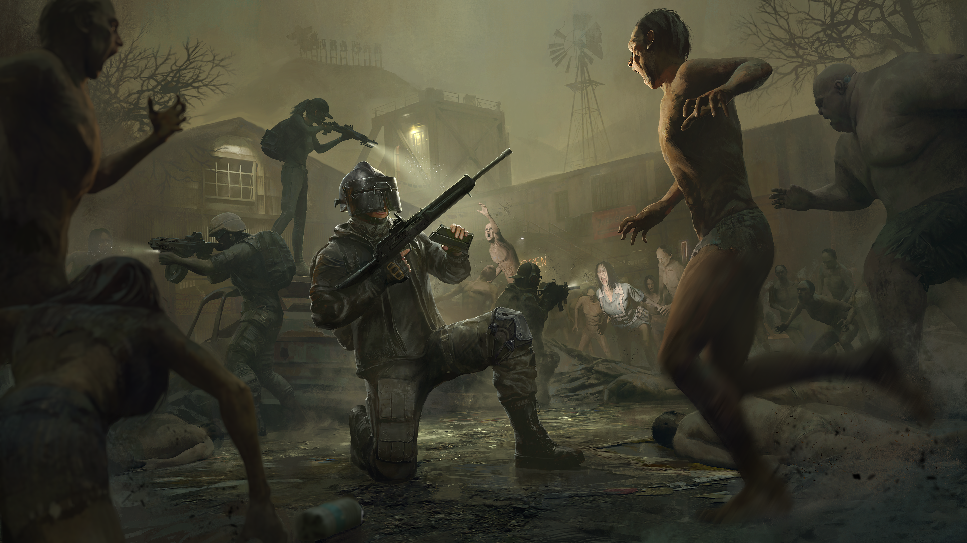


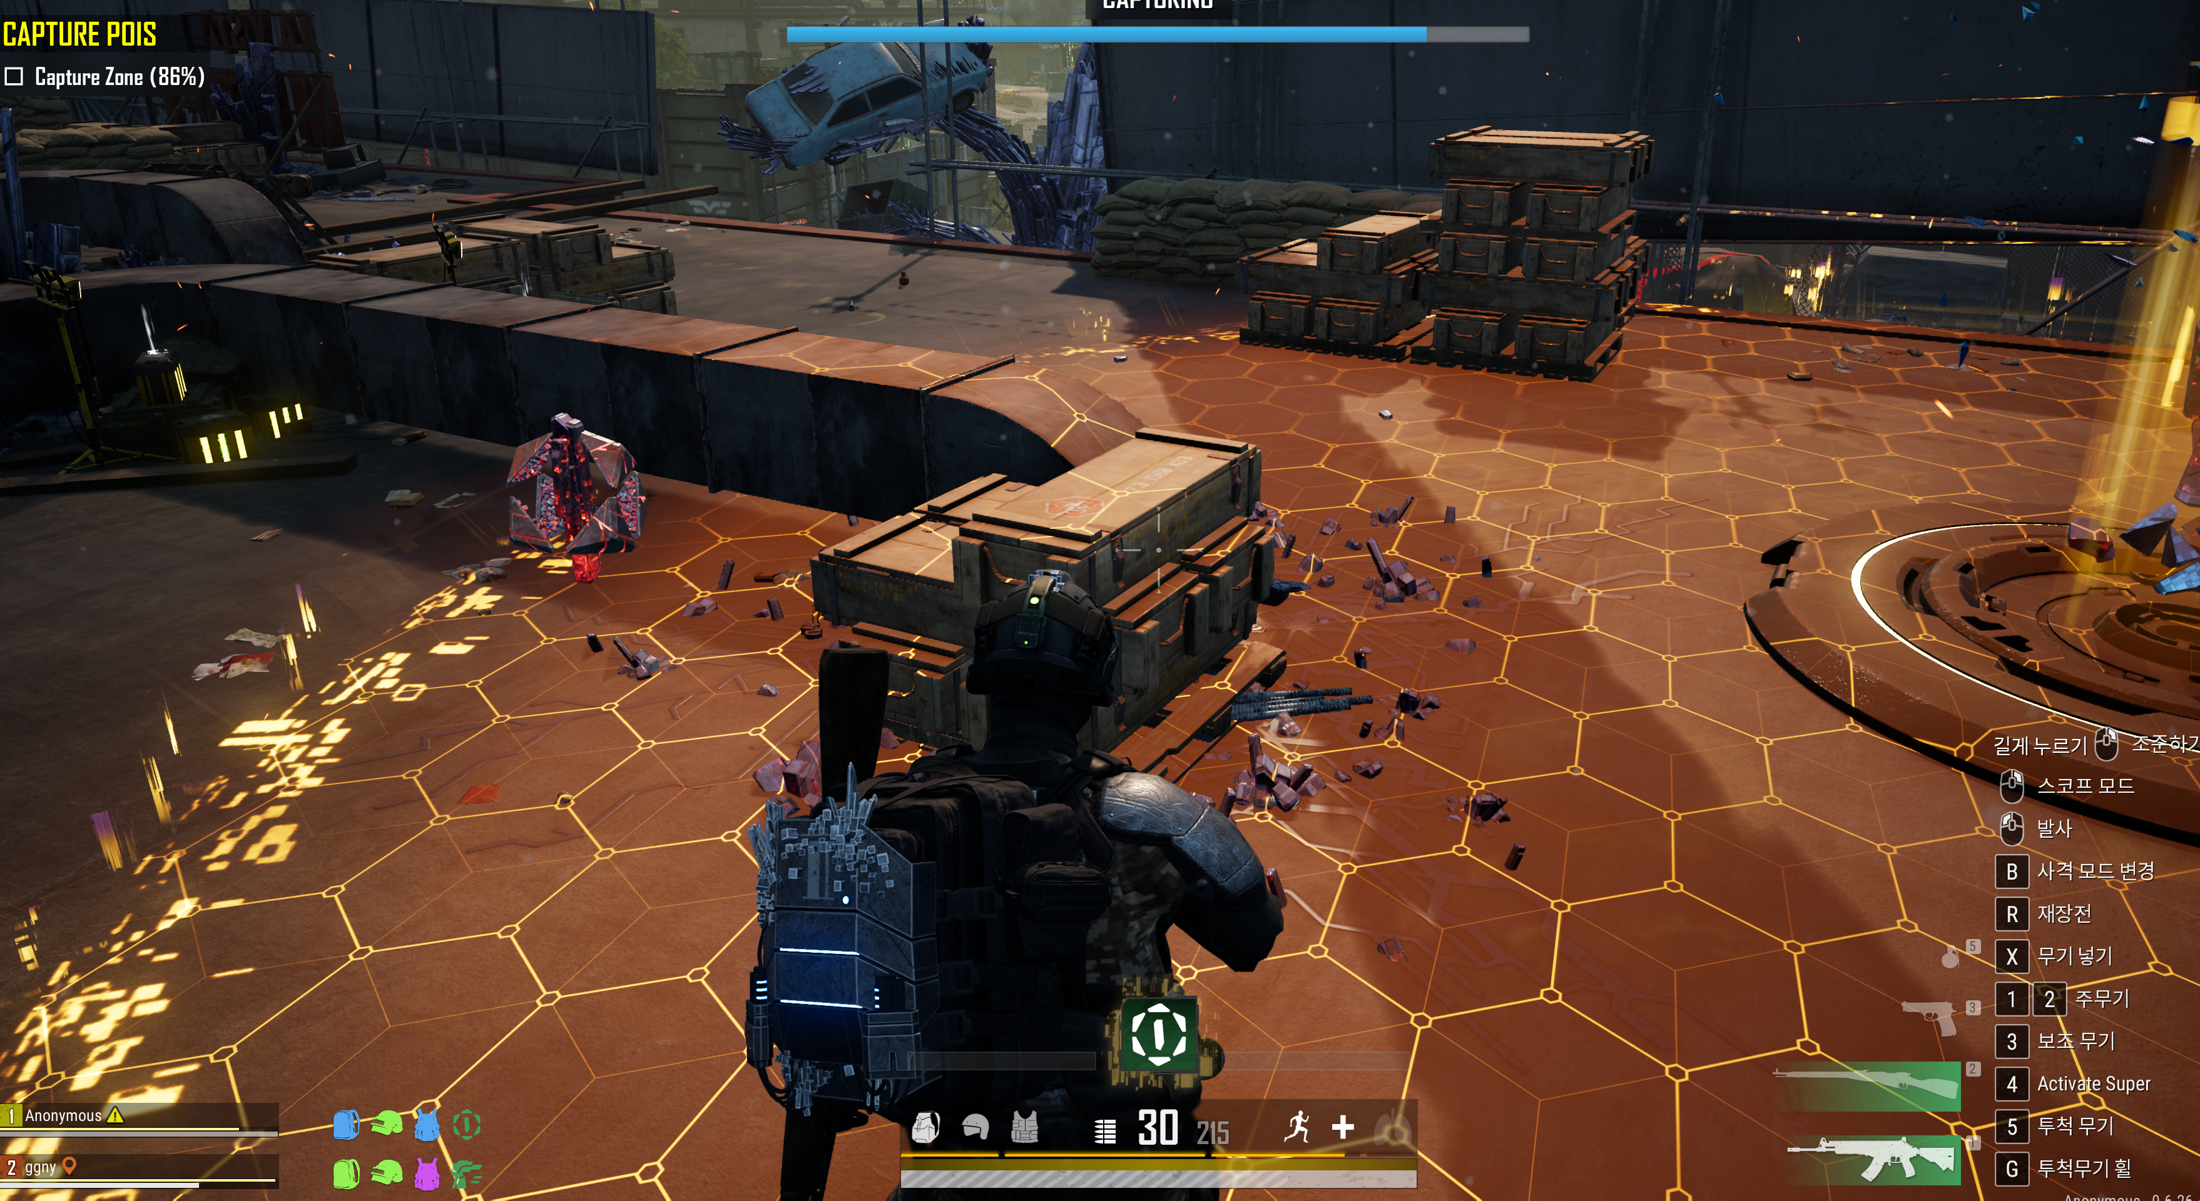

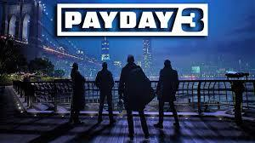
PUBG PC/Console 2026 Roadmap: h. 2026 User Incentive Strategy & Operations
Direction of event operations for 2026
Scale-up events based on rewards and content expansion to maximize peak-season traffic and stabilize off-season
Response methods
Key target seasons
Direction for 2026 events
Peak season
1Q (Lunar New Year, N-th anniversary, April Fool's Day)
Seasonality-driven promotion scale-up
Expand event scope based on existing main seasons and key updates
March N-th anniversary, July–August summer break, September Chuseok/Mid-Autumn Festival, December large-scale World Update
In addition to simple rewards and OES expansion, tie-in exposure- and engagement-based actions
E.g. content to drive streamer events, social challenges, e-sports event teasers and on-site events
Increase scale to attract interest from returning/engaged existing users and new users
Strengthen familiar enjoyment for existing/returning users and provide incentives for their return
Provide fresh entry points and differentiated experiences for new users
3Q (summer vacation, Chuseok/Mid-Autumn Festival)
4Q Year-end (large-scale World Update in December)
Off-season
2Q (Spring season after school starts in April–May)
New mode deployment and focused promotion
Placing newly developed Co-dev modes during off-peak timing to defend traffic and boost user engagement
E.g. new modes such as Binary Spot and Heist Royale, showcased as the main feature of the month with intensive promotion
Binary Spot
Content reinforcement and linked events needed to sustain a stable off-season
Move away from an anniversary-centric structure, and design a defense strategy that spans March to Q2 (the same after September/Chuseok)
Actively allocate promo rewards that can be used in promotions together with new modes/content placements to defend traffic
4Q (October–November, between Chuseok and year-end)
Heist Royale (Payday)

